Slide 1
Introduction to Software Quality Assurance and Testing
Chapter 1

Slide 2
Learning Objectives
Discuss the main purpose of quality assurance and testing
Discuss the terms testing and debugging
Talk about some different problems you have found with software
Describe the role of testing at Microsoft

Slide 3
The need for testing

Slide 4
My first ever program…
10 Print "HELLO"
20 GOTO 10
RUN
What does the program do?
How could we test the program?
Notes:
Written in Basic, this was probably similar to my first program. It would have been written on a computer in a shop called Dixons, which sold the computers. The program was probably on a Commodore Vic 20. It is a simple program, and I probably quickly went to change the content of the string in the first line.
What does the program do?
How could we test the program? We could let it run for a number of minutes and see what is displayed on the screen. How long should it run for? How long do we test it for?

Slide 5

How do we test that a camera captures the correct image?

Slide 6
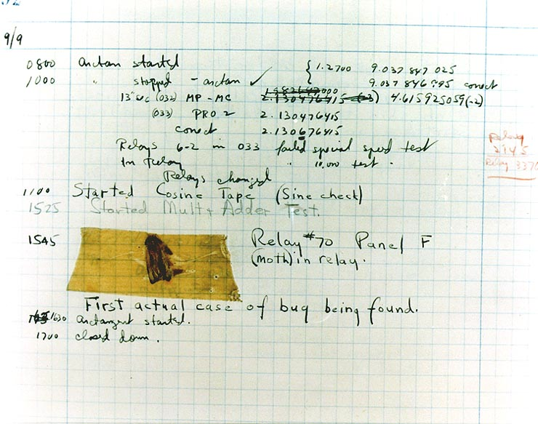
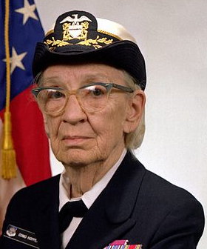
What is a software bug?
Image credit and license use: see Slide notes
Notes:
The image of Grace Hopper was released by the United States Navy with the ID DN-SC-84-05971 (available on Wikipedia) and it is in the public domain. http://commons.wikimedia.org/wiki/File:Commodore_Grace_M._Hopper,_USN_(covered).jpg
The image of the first “bug” is a work of a sailor or employee of the U.S. Navy, taken or made as part of that person's official duties. As a work of the U.S. federal government, the image is in the public domain. The image is available on wikipedia at http://commons.wikimedia.org/wiki/File:H96566k.jpg

Slide 7
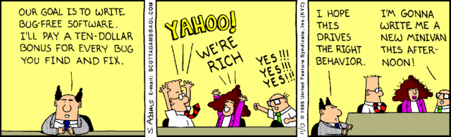
We can all create ‘bugs’
“If debugging is the process of removing bugs, then programming must be the process of putting them in.” E. J. Dijkstra*
Image credit and license use: see Slide notes
* The quote is sometimes accredited to Dijkstra, but I haven’t found the original source. Whether or not he said it, it has an element of truth.
Notes:
This image was published on November 13 1995 (ID 884318). It is used for free under the Dilbert Licensing by AMU Reprints for Classroom usage. Information is available at: http://www.amureprints.com/reprints/classroom

Slide 8
What is the purpose for testing?
There is no difference between testing and debugging
The purpose of testing is to show that the software works
The purpose of testing is to show that the software doesn’t work
The purpose of testing is not to prove anything specific, but to reduce the risk of using the software
Testing is a mental discipline that helps all IT professionals develop higher quality software
Notes:
Source: Introduction to Software Testing from Paul Ammann and Jeff Offutt, Cambridge University Press, although the original discussion is also linked to the Art of Software Testing by Myers, Badgett and Sandler (3rd edition).
C

Slide 9
The purpose (goal) of testing
“If our goal is to demonstrate that a program has no errors, then we will be steered subconsciously toward this goal; that is, we tend to select test data that have a low probability of causing the program to fail. On the other hand, if our goal is to demonstrate that a program has errors, our test data will have a higher probability of finding errors. The latter approach will add more value to the program than the former.”
Myers, Badgett, Sandler, “The Art of Software Testing”, 2012, John Wiley & Sons, Inc., New Jersey, USA.

Slide 10
Your Experience
What is the biggest piece of software you've ever written?
How did you test it?
Did it still have bugs?
What kind of bugs in software annoy you the most?
What is the worst bug you have ever found?

Slide 11
Exercise
On your own: think of some different examples of the use of software and the possible risks if the software fails
In small groups: discuss these examples
With the class: we will then discuss your examples

Slide 12
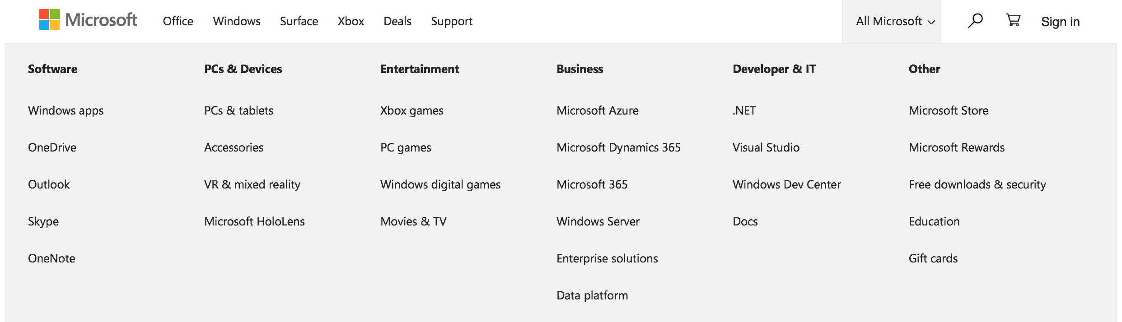
Microsoft’s Experience

Slide 13
Microsoft’s Experience
100 major product families (possibly more)
80 languages and dialects (possibly more)
4 Engineering Groups
Cloud and AI
Experiences and Devices
AI and Research
Core Services and Engineering
In 2008, there were a reported 35,000 software engineers (how many do you think are test engineers?)
More recent company information suggests 67,000 engineers, but no information on how many might be involved in testing
Note – Looking at Facts About Microsoft, we might estimate that the number of engineers at approximately 67,000. See https://news.microsoft.com/facts-about-microsoft/#EmploymentInfo

Slide 14
Microsoft’s Experience
From previous slide:
In 2008, there were a reported 35,000 engineers
Of these, 9,000 test engineers - about 25% of the total number of engineers
100,000 computers running tests

Slide 15
The challenge of scale
Real projects might be 50,000 lines of code or 5 million lines of code
They are linked to libraries which change and might cause failures in this code
Complex systems can have unforeseen interactions between different parts of the system
In this course, we will think about how we manage real systems such as those that Microsoft make

Slide 16
Any Questions?

Slide 17
Basic Terminology

Slide 18
Errors, Faults and Failures
There are different aspects to the problems we find in software.
Error
Fault
Failure
System
Incidents
Users

Slide 19
Errors, Faults and Failures
Errors (or mistakes) – A problem that is introduced into a system during development.
Faults (defects) - A result of an error.
If a designer makes an error that adds something that we don’t want, the fault is incorrect execution.
If a designer makes an error that misses out something, then the fault is something that is not in the software.
Failures – The result when a fault executes.
Incidents – The symptoms that indicates that there is a fault.
Notes:
Taken from Jorgensen, p4, based on IEEE definitions.

Slide 20
Test Cases
In testing, we develop different test cases
A set of inputs to a system
An expected output
Each test case should be identifiable(可辨认), e.g. assigned a Test ID
We should review the outputs of tests to check if they reveal any problems and areas for further testing

Slide 21
Relationship between Development, Testing and Quality Assurance

Slide 22
Testing and the Lifecycle
How do we make software of the size and complexity of Microsoft and other companies…?
Back to Software Lifecycle module:
Make sure people build things with right tools and methods
Make sure the system has a sensible architecture
Use walkthroughs to make sure we agree on what is being done and how it is being done
TESTING is also a vital part of this process

Slide 23
The Joel Test on how to better code http://www.joelonsoftware.com/articles/fog0000000043.html
Do you use source control?
Can you make a build in one step?
Do you make daily builds?
Do you have a bug database?
Do you fix bugs before writing new code?
Do you have an up-to-date schedule?
Do you have a spec?
Do programmers have quiet working conditions?
Do you use the best tools money can buy?
Do you have testers?
Do new candidates write code during their interview?
Do you do hallway usability testing?

Slide 24
What is a good score?
"A score of 12 is perfect, 11 is tolerable, but 10 or lower and you've got serious problems.
The truth is that most software organizations are running with a score of 2 or 3, and they need serious help, because companies like Microsoft run at 12 full-time.”
Joel Spolsky, joelonsoftware.com

Slide 25
Where testing fits
Testing checks your daily building (2,3)
Testing shows that bugs have been fixed (4,5)
Testing indicates how you are doing against the schedule (6)
Testing validates development against the specification (7,10)
Usability testing checks you are building what users want (12)

Slide 26
The Joel Test on how to better code http://www.joelonsoftware.com/articles/fog0000000043.html
Do you use source control?
Can you make a build in one step?
Do you make daily builds?
Do you have a bug database?
Do you fix bugs before writing new code?
Do you have an up-to-date schedule?
Do you have a specification?
Do programmers have quiet working conditions?
Do you use the best tools money can buy?
Do you have testers?
Do new candidates write code during their interview?
Do you do hallway usability testing?
Notes:
Included here again so that it is quick to refer to it from the previous slide.

Slide 27
Software Quality
Software Quality Management is concerned with ensuring that developed software systems are ‘fit for purpose.’
From: Sommerville, “Software Engineering, Global Edition’
We need processes and standards that should help a team to develop high-quality products
We need to check that the processes and standards have been followed
We will be thinking further about Software Quality and how it can be managed

Slide 28
Test everything?

Slide 29
Test Everything?
Is it possible to test all possible aspects of a program?
Why do you think that?
What is considered ‘good enough’? Some topics:
Test early and test often
Integrate development and testing lifecycles
Formalize the testing methodology
Develop a comprehensive test plan
Use static and dynamic testing
Balancing time, money and quality

Slide 30
One view of Google’s Experience
http://www.google.com/googlebooks/chrome/
The document is covered by the license
http://creativecommons.org/licenses/by-nc-nd/2.5/legalcode

Slide 31
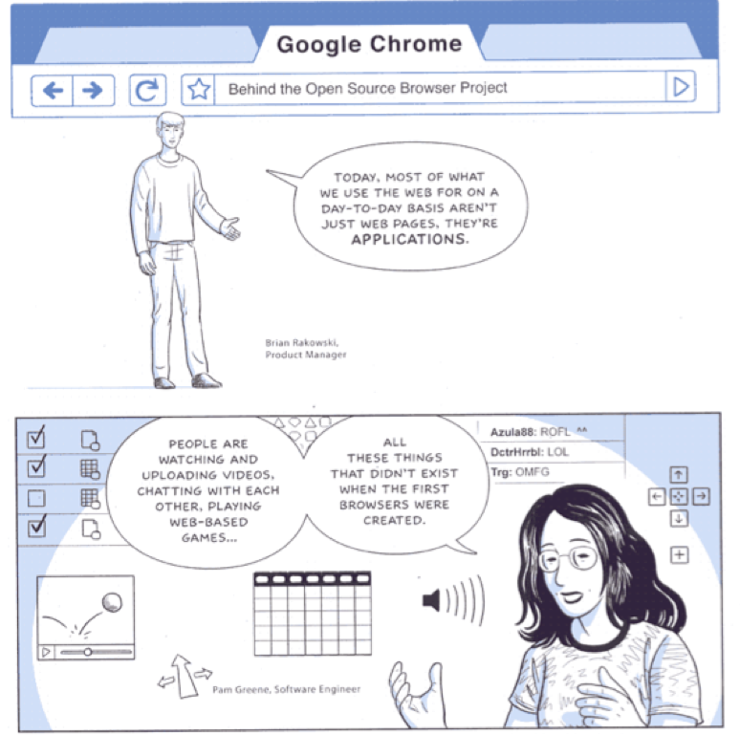

Slide 32
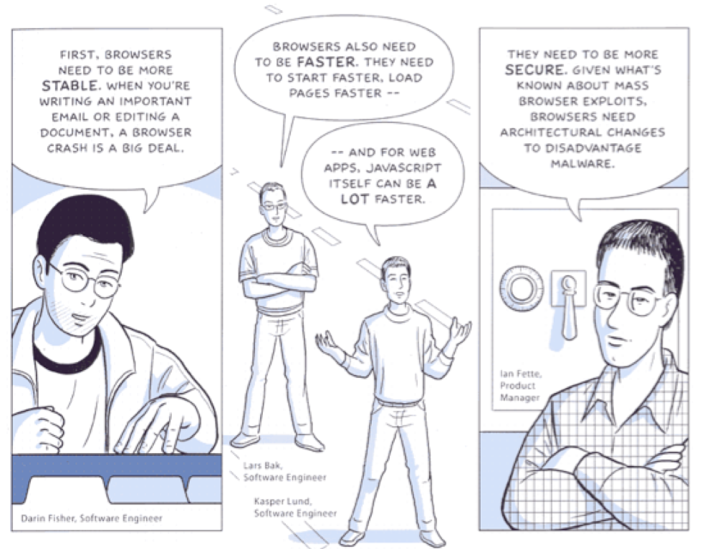

Slide 33
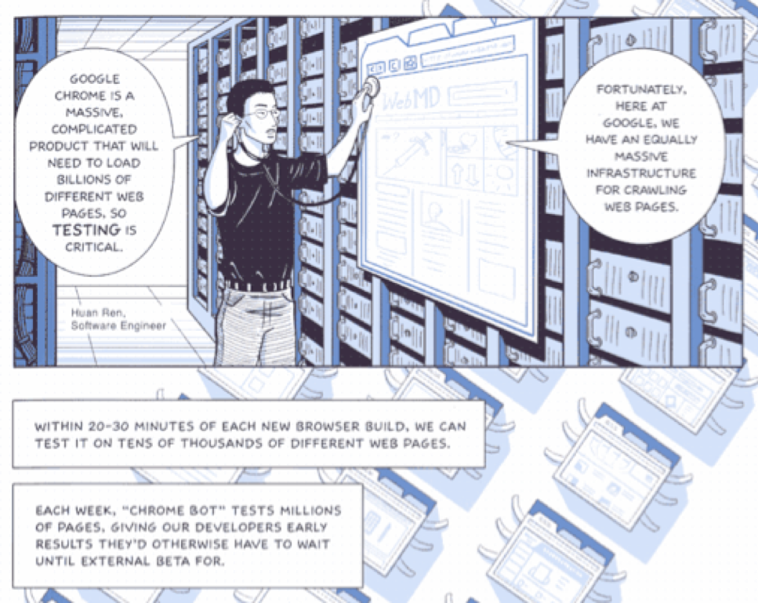

Slide 34
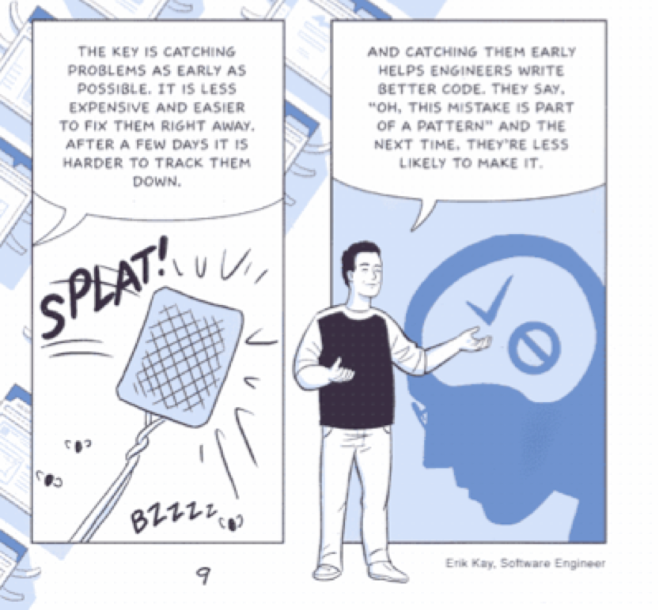

Slide 35
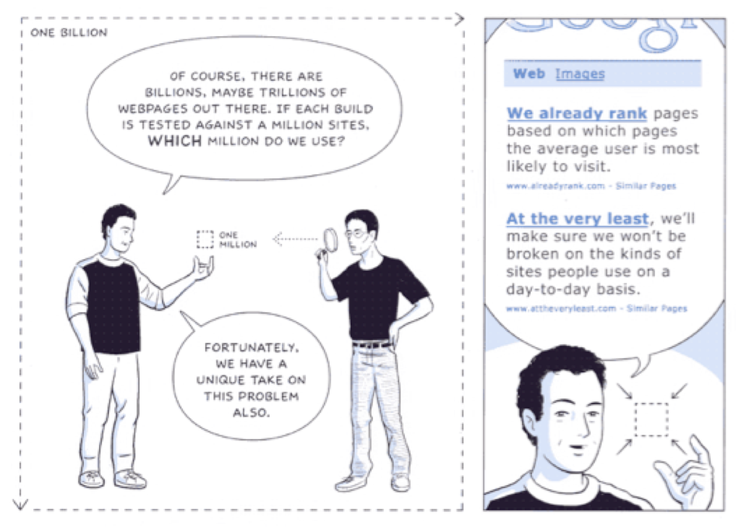

Slide 36
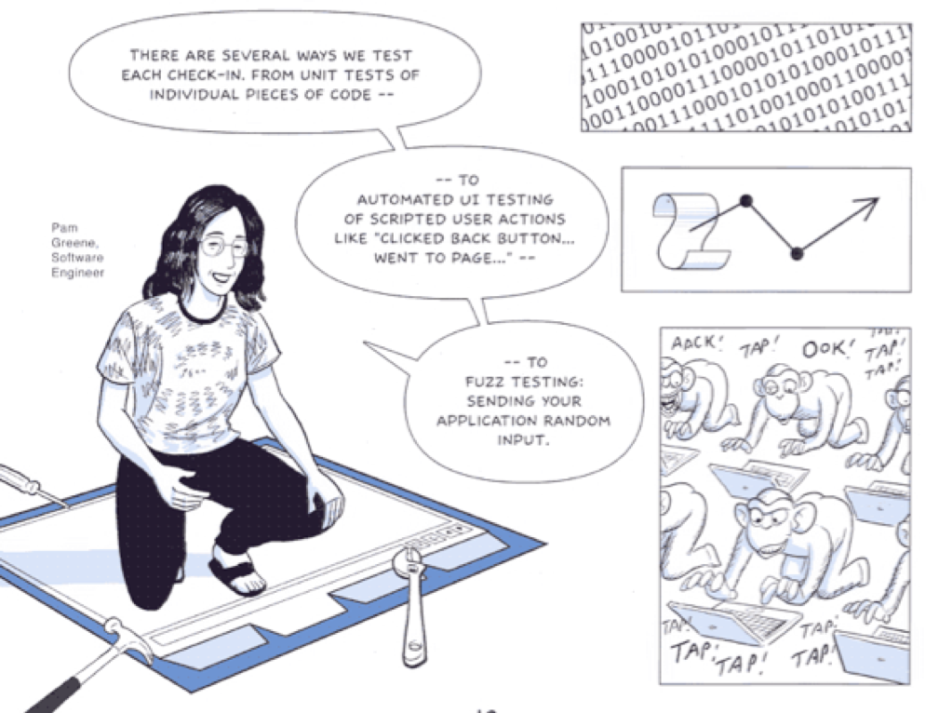

Slide 37
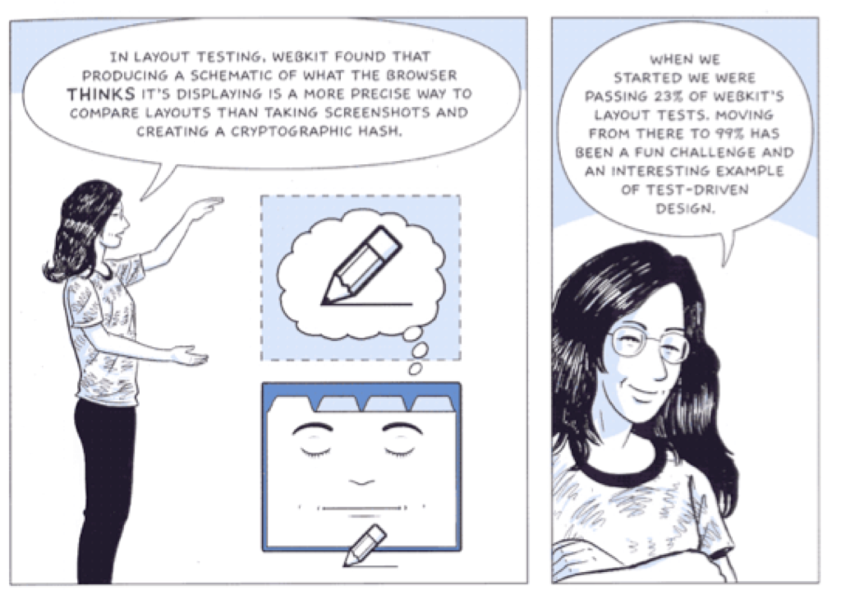

Slide 38
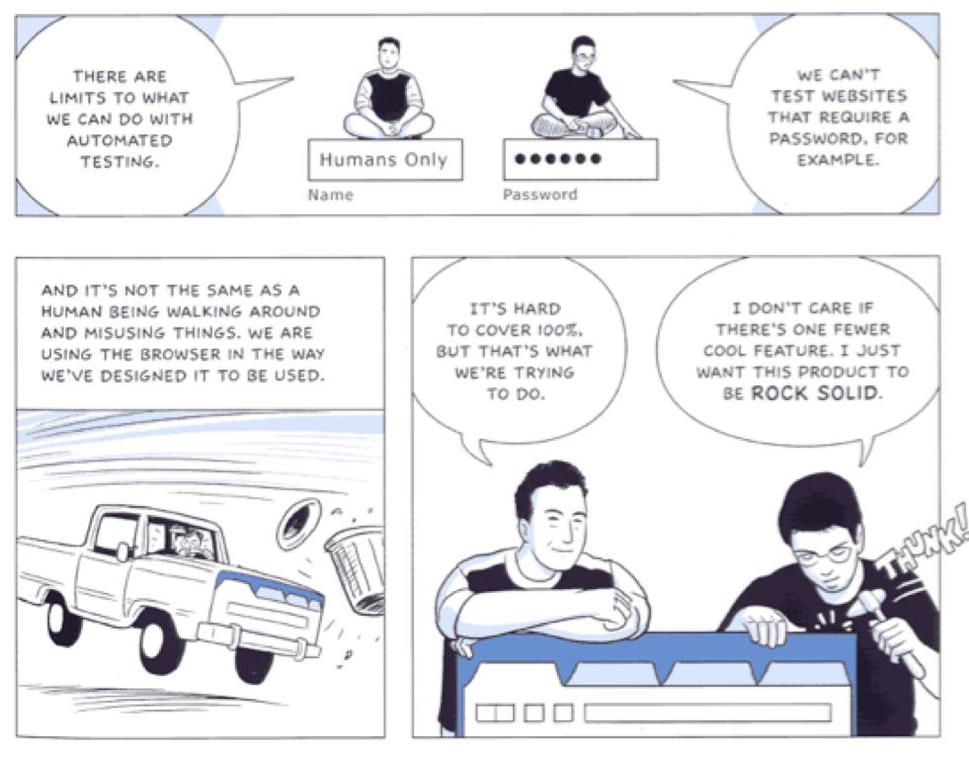

Slide 39
Summary
Terms:
Error, Fault, Failure, Incident, Test Case
Relationship between testing and development
Joel’s example list of points for good development practice
The need for automation at different levels of testing
Example of testing at Google

Slide 40
Any Questions?

